Slide 1
Programming languages: Java

Slide 2
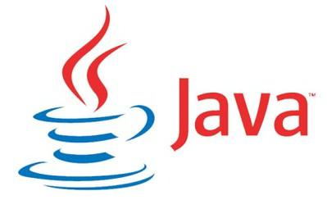
Introduction to Java
High-level, class-based, object-oriented programming language
Developed by Sun Microsystems in 1995 (now Oracle)
"Write Once, Run Anywhere" philosophy: designed to be portable and run on any machine regardless of architecture (JVM)

Slide 3
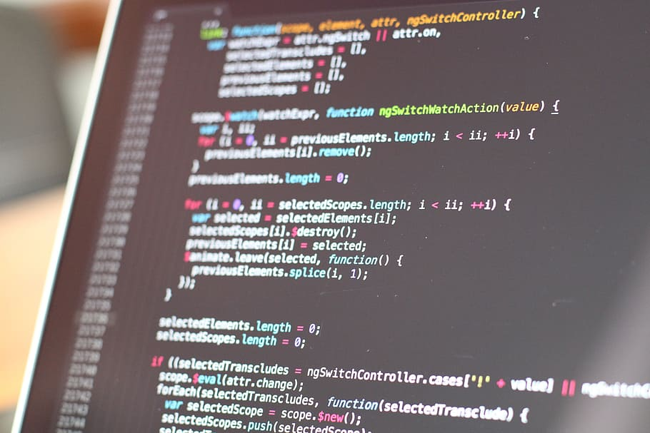
Java's Syntax Characteristics
Similar to C/C++ but has fewer low-level facilities and more simplified object-oriented concepts
Uses curly braces `{}` for defining blocks of code
Semicolon `;` to end statements
Strongly typed language: must declare variable types

Slide 4
Basic Java Code Example
public class HelloWorld {
public static void main(String[] args) {
System.out.println("Hello, World!");
}
}

Slide 5
Strengths of Java
Platform-independent: Java bytecode runs on any machine with a Java Virtual Machine (JVM)
Rich standard library
High performance
Strong memory management and security features
Huge community support and extensive frameworks
Lot of developers

Slide 6
Weaknesses and Criticisms
Verbosity: Java code can be longer compared to some modern languages
Memory consumption: Java applications can be resource-intensive
Limited facilities for low-level manipulation

Slide 7
Use Cases
Web applications: Spring
Android app development: Java is the primary language for writing native Android applications
Enterprise software and large systems
Scientific applications: natural language processing, neural networks, computational finance (Apache Commons Math)
Big data: Apache Hadoop, Apache Spark etc that run on JVM

Slide 8
Thank you!
Q & A

